Slide 1
Making Text for the Web part 4
Barb Ericson
Georgia Institute of Technology
March 2006

Slide 2
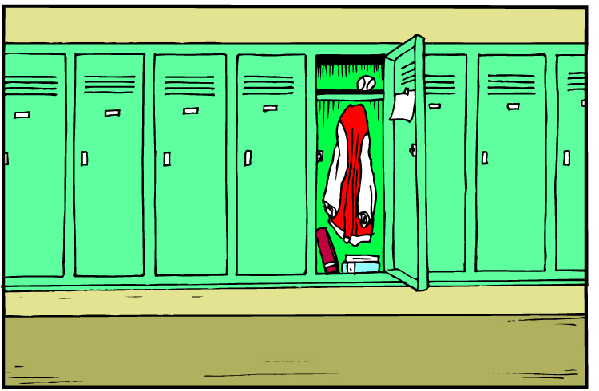
Maps
Use maps to store key and value pairs
  Related data
Put a value in the map
  For a key
Get a value out of a map
  Using the key
No duplicate keys
  Can have duplicate values
Notes:
Maps are like post office boxes or lockers. If you have a key you can put stuff in the box or locker and if you have a key you can get it out.

Slide 3
Map Interface
Get the number of keys in the map
  public int size();
Put a value in the map for the given key
  Returns the old object stored for this key
  public Object put(Object key, Object value);
Get a value from the map for the given key
  public Object get(Object key);
Check if the key is used in the map
  public boolean containsKey(Object key);
Get a set of the keys used in the map
  public Set keySet();

Slide 4
Map Interfaces and Classes
<<interface>>
Map
Notice that one
interface can
inherit from another
HashMap
Hashtable
<<interface>>
SortedMap
Used when you
don't need the code to
be thread safe
Used when the keys
should be kept
sorted
TreeMap
Used when you
do need the code
to be thread safe
Notes:
By thread safe we mean that multiple thread might access it at the same time.

Slide 5
Husband to Wife Example Map
> import java.util.*;
> Map wifeMap = new HashMap();
> wifeMap.put("Fred","Wilma");
> wifeMap.put("Barney","Betty");
> System.out.println("Fred's wife is " + wifeMap.get("Fred"));
Fred's wife is Wilma
> System.out.println("Barney's wife is " + wifeMap.get("Barney"));
Barney's wife is Betty

Slide 6
Programming Tip
When declaring variables use the interface name when possible
  Declare wifeMap to be a Map not a HashMap
  You can declare objects to be of the interface type
    If the class that you are assigning to the variable implements the interface
  This makes it easy to change the class at a latter date to another class
    That implements the same interface
  If we decide to keep the keys sorted we could change HashMap to TreeMap
    With only one change

Slide 7


Goals of Object-Oriented Design
Decrease coupling: the degree to which two components depend on each other’s implementations (minimize the effect of changes)
Increase cohesion: the degree to which the responsibilities of a class are related (maximize the ability to combine objects)
Notes:
Chapter 1 - <number>
Train cars are coupled together so that when one moves the other will. We want our classes to be decoupled so that when one is changed the others are not affected.

Slide 8
Downcasting
Both the key and value in a map must be objects
  So when you put a value in a map it is treated as an object
When you pull it back out
  You will need to downcast if you want to treat it as something other than an object
    Unless you use generics
  The compiler only knows what something is declared to be
    Not what it really is

Slide 9
Without a Downcast to String
Compile and run the following:
import java.util.*;
public class MapTest
{
public static void main(String[] args)
{
String key = "theKey";
Map testMap = new HashMap();
testMap.put(key,"theValue");
String value = testMap.get(key);
}
}
Notes:
You will get an incompatible types error when you try to put the Object in the map into a String, unless you use a downcast.

Slide 10
With the Downcast to String
import java.util.*;
public class MapTest
{
public static void main(String[] args)
{
String key = "theKey";
Map testMap = new HashMap();
testMap.put(key,"theValue");
//String value = testMap.get(key);
String value = (String) testMap.get(key);
}
}

Slide 11
Downcasting
A conversion from a more general type to a more specific type
  Object to String
Tells the compiler to treat the object as a String
  If it isn't a String object at runtime you will get a ClassCastException
Casting to an integer is also downcasting
  (int) 10.5 / 3 = 3
  Which throws away the part after the decimal point

Slide 12
Phone Book Class
/**
* A class that represents a phone book. This phone
* book maps names to phone numbers. This will
* read the phone book information from a file.
*/
public class PhoneBook
{
/////////////////// fields /////////////////////////
private String fileName;
private Map phoneMap = new HashMap();
////////////////// constructors ////////////////////
/**
* Constructor that takes a file name and reads
* in the names and phone numbers from a file
* @param file the name of the file to read
*/
public PhoneBook(String file)
{
this.fileName = file;
// read the map information in from the file
readInfoFromFile();
}

Slide 13
PhoneBook Class (Continued)
/////////////////// methods /////////////////////
/**
* Get the phone number for the passed name
* @param name the name to look up in the map
* @return the phone number if found, else null
*/
public String getPhoneNumber(String name)
{
String phoneNumber = (String) phoneMap.get(name);
return phoneNumber;
}
/**
* Method to read the phone information from a
* file and use it to fill the map
*/
public void readInfoFromFile()
{
String line = null;
String[] phoneArray = null;

Slide 14
PhoneBook Class (Continued)
try {
// create the reader
BufferedReader reader =
new BufferedReader(new FileReader(fileName));
// loop reading from the file
while ((line = reader.readLine()) != null)
{
if (line.indexOf(":") >= 0)
{
phoneArray = line.split(":");
phoneMap.put(phoneArray[0].trim(),
phoneArray[1].trim());
}
}
// close the reader
reader.close();
} catch (FileNotFoundException ex) {
SimpleOutput.showError("Couldn't find file " + fileName);
} catch (Exception ex) {
ex.printStackTrace();
}
}

Slide 15
Test the PhoneBook Class
/* main for testing */
public static void main(String[] args)
{
PhoneBook phoneBook = new PhoneBook("barbsPhoneBook.txt");
System.out.println(phoneBook.getPhoneNumber(
"Shayna"));
System.out.println(phoneBook.getPhoneNumber(
"Dentist"));
}

Slide 16
Iterating through a Map
What if we want to see all the items in our phone book?
  Get the keys
    Use keySet() to get a set of keys for a map
  Use each key to get the value for that key
    Using an iterator on the set of keys
Iterators
  An interface that lets you get each item from a collection
    Use hasNext() to see if more in the iterator
    Use next() to get the next item
    Need to downcast the key

Slide 17
Print out the Phone Book
/**
* Method to print out the contents of the phone book
*/
public void printBook()
{
// get the set of keys
Set keySet = phoneMap.keySet();
String key = null;
// loop through the keys
Iterator iterator = keySet.iterator();
while (iterator.hasNext())
{
key = (String) iterator.next();
System.out.println("Name: " + key +
", Phone number: " +
phoneMap.get(key));
}
}

Slide 18
Generics
Java 5.0 (1.5) added generics
  Allow you to specify the types of things in collection classes
    When you declare a collection variable
      private Map<String,String> phoneMap =
      new HashMap<String,String>();
  You no longer have to downcast when you get items out of a collection
    If you have used generics
      String phoneNumber = phoneMap.get(name);

Slide 19
Using a For Each Loop to Print the Book
/**
* Method to print out the contents of the phone book
*/
public void printBook()
{
// get the set of keys
Set<String> keySet = phoneMap.keySet();
// loop through the keys
for (String key : keySet)
{
System.out.println("Name: " + key +
", Phone number: " + phoneMap.get(key));
}
}

Slide 20
Exercise
Modify the PhoneBook class to use a TreeMap
  Is anything different from before?
Create a PictureBook class that maps a person's name to his or her picture
Add a method getName(String phoneNumber) to the PhoneBook class
  How can you quickly find the name for the phone number?

Slide 21
Summary
Maps allow you to store key and value pairs
  Can have duplicate values but not duplicate keys
Map is an interface
  HashMap, Hashtable and TreeMap all implement the interface
You can use an iterator to loop through elements of a collection
You can use generics when you declare a collection
  And when you create it
  This removes the need to downcast when you pull an item back out of a collection

